Slide 1


© 2014 Microsoft Corporation. All rights reserved. Microsoft, Windows, and other product names are or may be registered trademarks and/or trademarks in the U.S. and/or other countries.
The information herein is for informational purposes only and represents the current view of Microsoft Corporation as of the date of this presentation. Because Microsoft must respond to changing market conditions, it should not be interpreted to be a commitment on the part of Microsoft, and Microsoft cannot guarantee the accuracy of any information provided after the date of this presentation. MICROSOFT MAKES NO WARRANTIES, EXPRESS, IMPLIED OR STATUTORY, AS TO THE INFORMATION IN THIS PRESENTATION.

Slide 2

Microsoft
DevCamp
Universal Windows Apps & cross-platform

Slide 3
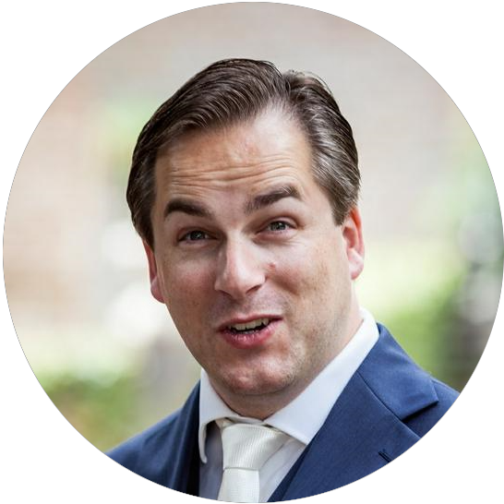


Clemens Schotte
@cschotte
cschotte@microsoft.com
Martin Tirion
@mtirion
mitirion@microsoft.com
Rajen Kishna
@rajen_k
rajenki@microsoft.com

Slide 4
Agenda
09:00 – 10:00 Windows 10
10:00 – 10:30 Scaling from the small screen to the big screen
10:30 – 10:45 Break
10:45 – 11:15 Data binding and MVVM
11:15 – 12:15 Hands-On 1
12:15 – 13:00 Lunch
13:00 – 13:15 Recap Hands-On 1
13:15 – 14:15 Cross-platform App Development
14:15 – 14:45 App packaging, monetization and publication
14:45 – 15:30 Advanced Topics
15:30 – 15:45 Break
15:45 – 16:45 Hands-On 2
16:45 – 17:00 Recap Hands-On 2

Slide 5
Hands-on
http://aka.ms/WinCampNL
of
https://github.com/DXNL/wincamp

